Slide 1

"Insurance Risk & Policy Analytics Dashboard"
By: Abhay Singh Thakur

Slide 2
Goal
To create interactive dashboards that help the insurance company understand its customers better, manage risks effectively, and improve decision-making using data insights.

Slide 3

Objective 1:
How do customer demographics influence insurance choices?
What is the average premium amount across different age groups?
Which occupations tend to invest in higher insurance premiums?
How does education level influence the type of insurance products owned?

Slide 4
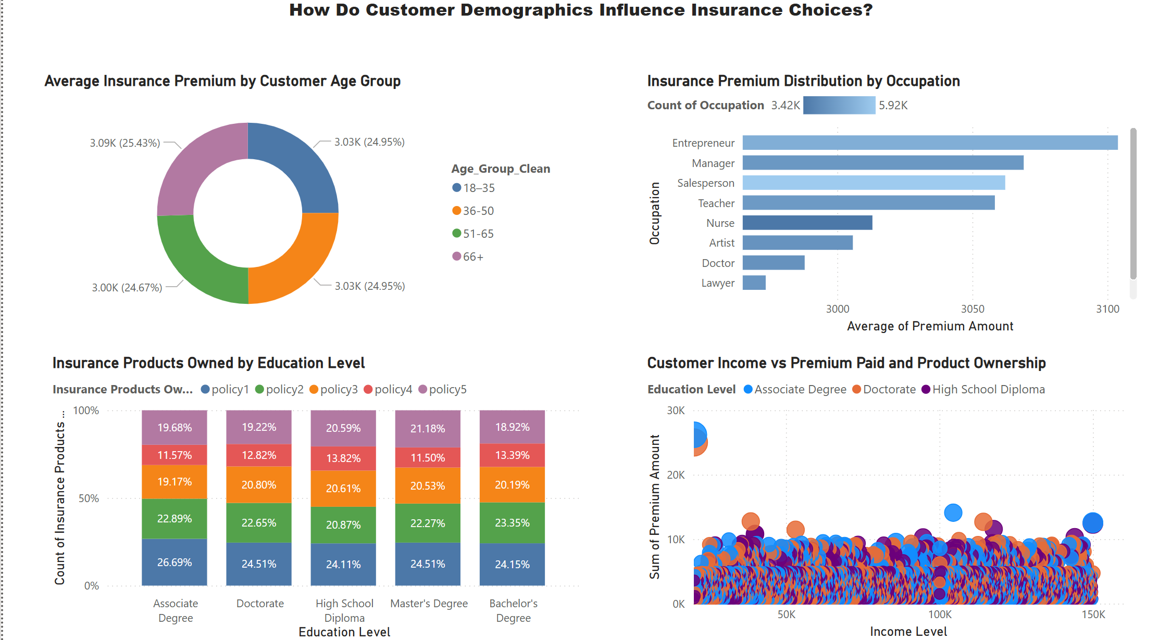

Slide 5
Objective 2:
What patterns exist between customer risk levels and their claim behavior?
Do customers with lower credit scores file more claims?
How does the risk profile affect the number of claims made?
Are specific life events (like job change or childbirth) linked to higher-risk customers?

Slide 6
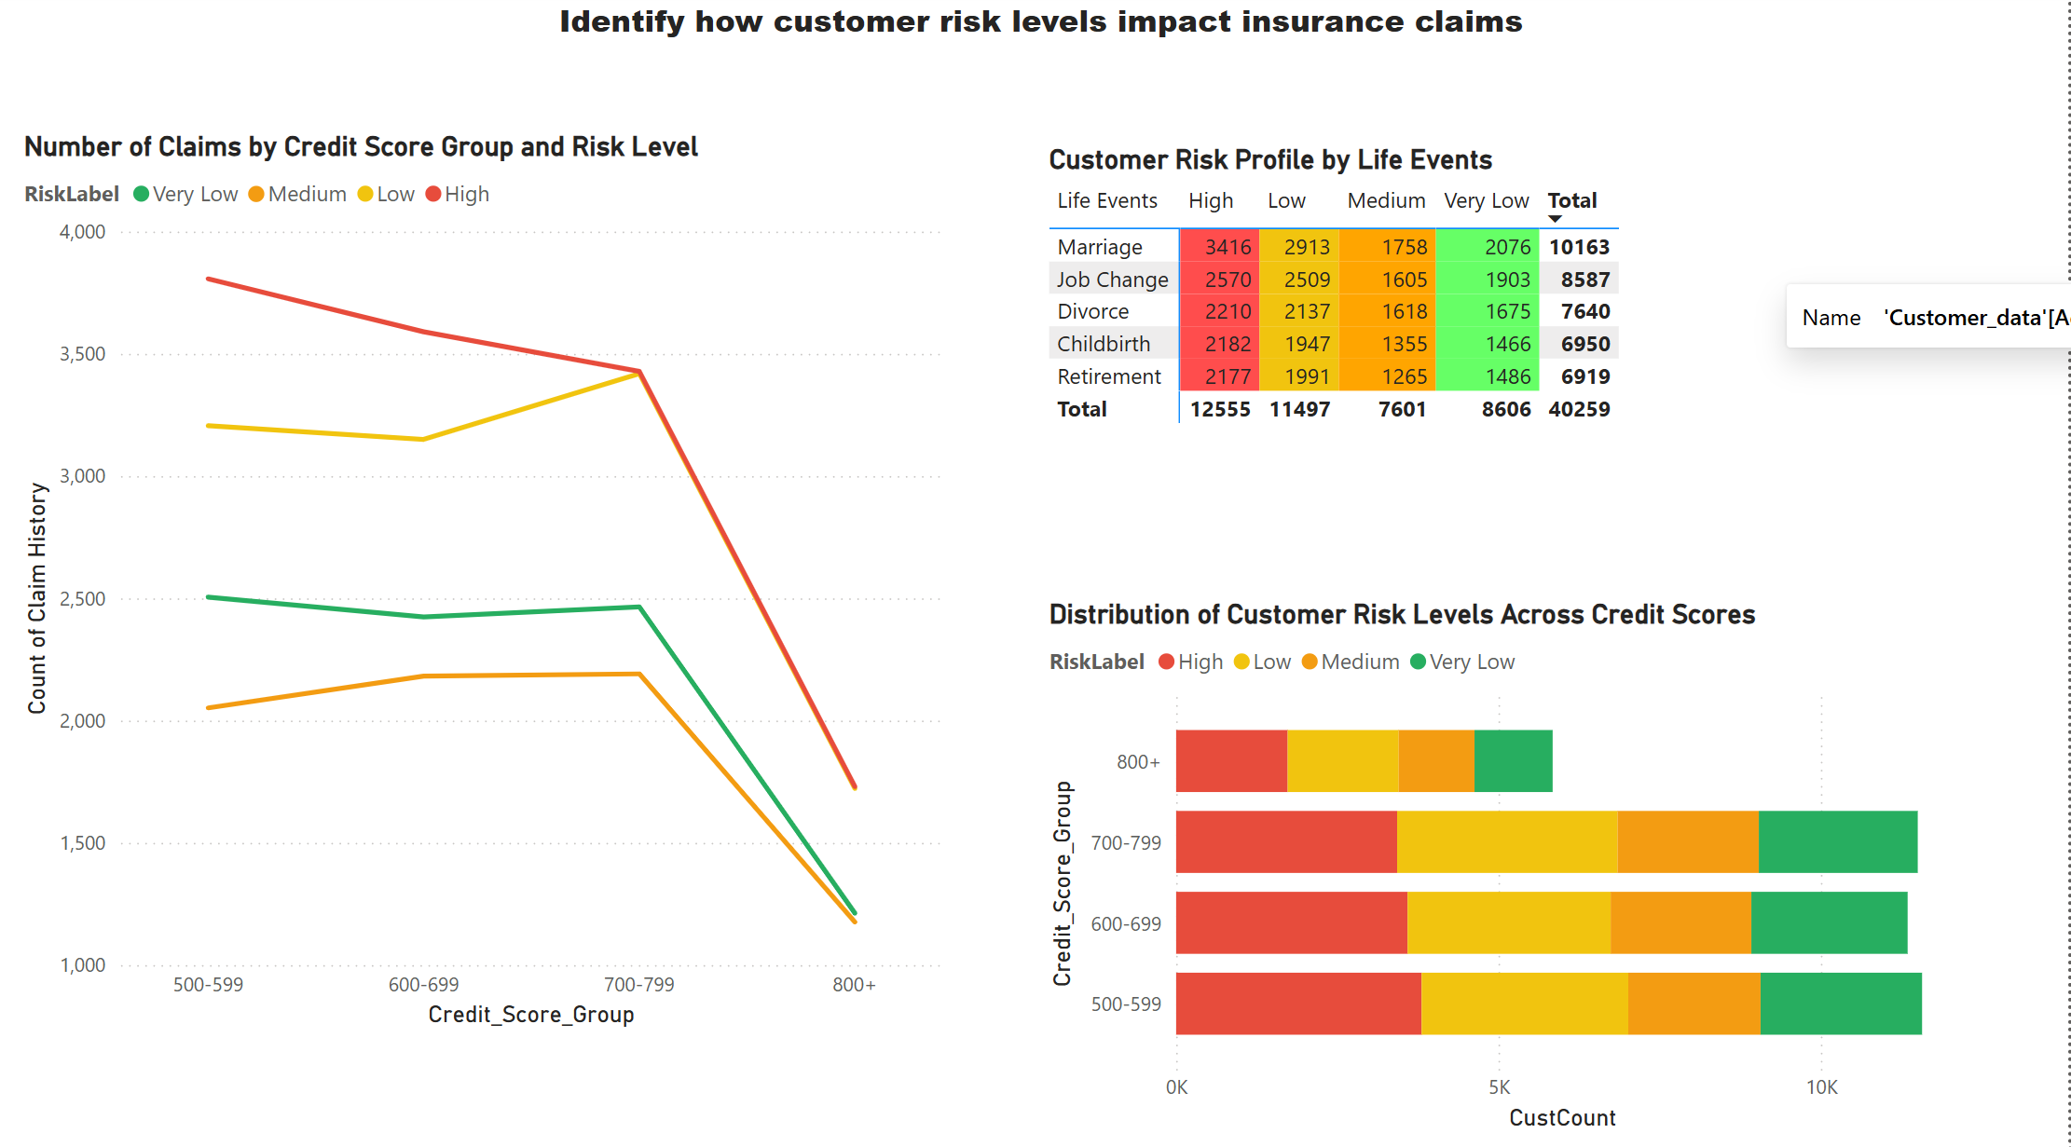

Slide 7

Objective 3:
How do customer preferences vary when it comes to communication and contact methods?
What is the most preferred communication channel (email, text, in-person)?
Which contact time preferred (morning, afternoon, weekend) ?
Is there a trend in language preference based on region or customer group?

Slide 8
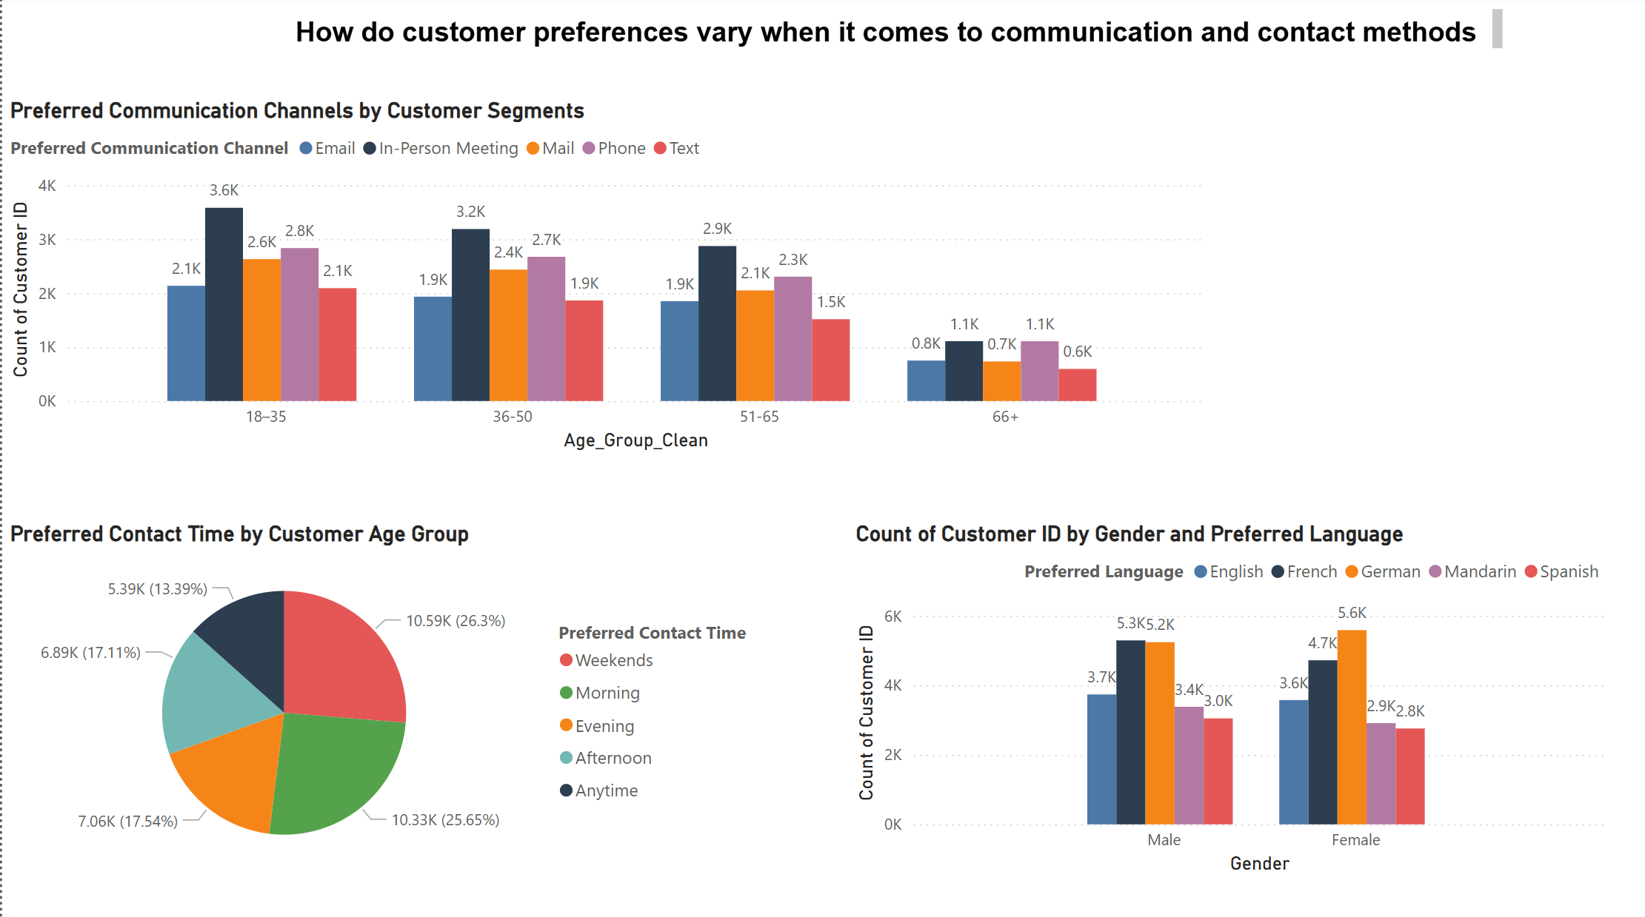

Slide 9
Thank you!

